Slide 1
Object Oriented Analysis and Design
Component Diagrams

Slide 2
Component Diagrams
Component diagrams are used in modeling the physical aspects of object-oriented systems in representation of the dependencies and interactions between software components, for visualizing, specifying, and documenting components

Slide 3
Component Diagram
It does not describe the functionality of the system
It describes the components used to make those functionalities. ( static implementation view)
Visualize the physical components in a system.
These components are libraries, packages, files etc.

Slide 4
Component Diagram
Initially the system is designed using different UML diagrams and then when the artifacts are ready component diagrams are used to get an idea of the implementation.

Slide 5
How
Identify Libraries and other artifacts relevant to the application.
Identify Relationships among the artifacts

Slide 6

UML 2.x component.

Slide 7
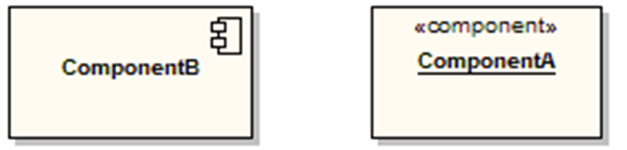
Components
Components are represented as a rectangular classifier with the keyword «component»; optionally the component may be displayed as a rectangle with a component icon in the right-hand upper corner.

Slide 8

Assembly Connector - Interface
The assembly connector bridges a component’s required interface (Component1) with the provided interface of another component (Component2)
This allows one component to provide the services that another component requires.

Slide 9
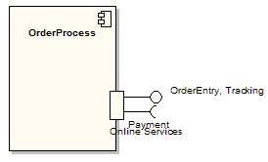
Ports
Ports are depicted as small squares on the sides of classifiers.
A port is a feature of a component that specifies interaction with its environment.

Slide 10
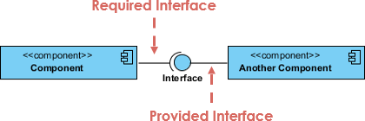
Provided interface
Provided interface - provide the services that another component requires
Required interface – require services from another component

Slide 11
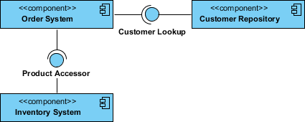
Component Diagram Example
(Order System)

Slide 12
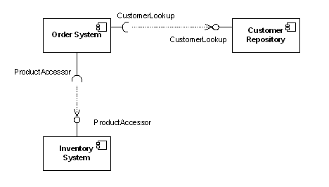
Dependency
Shows that one part of system depends on another
Order system depends on customer repository and Inventory system

Slide 13
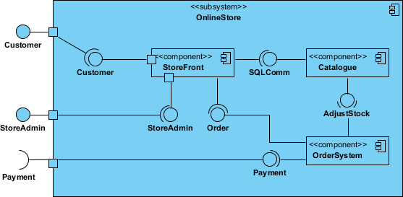
Subsystems

